Slide 1
Always exit through the gift shop:
Lessons from raising a child with dessh
Skyla Anders

Slide 2
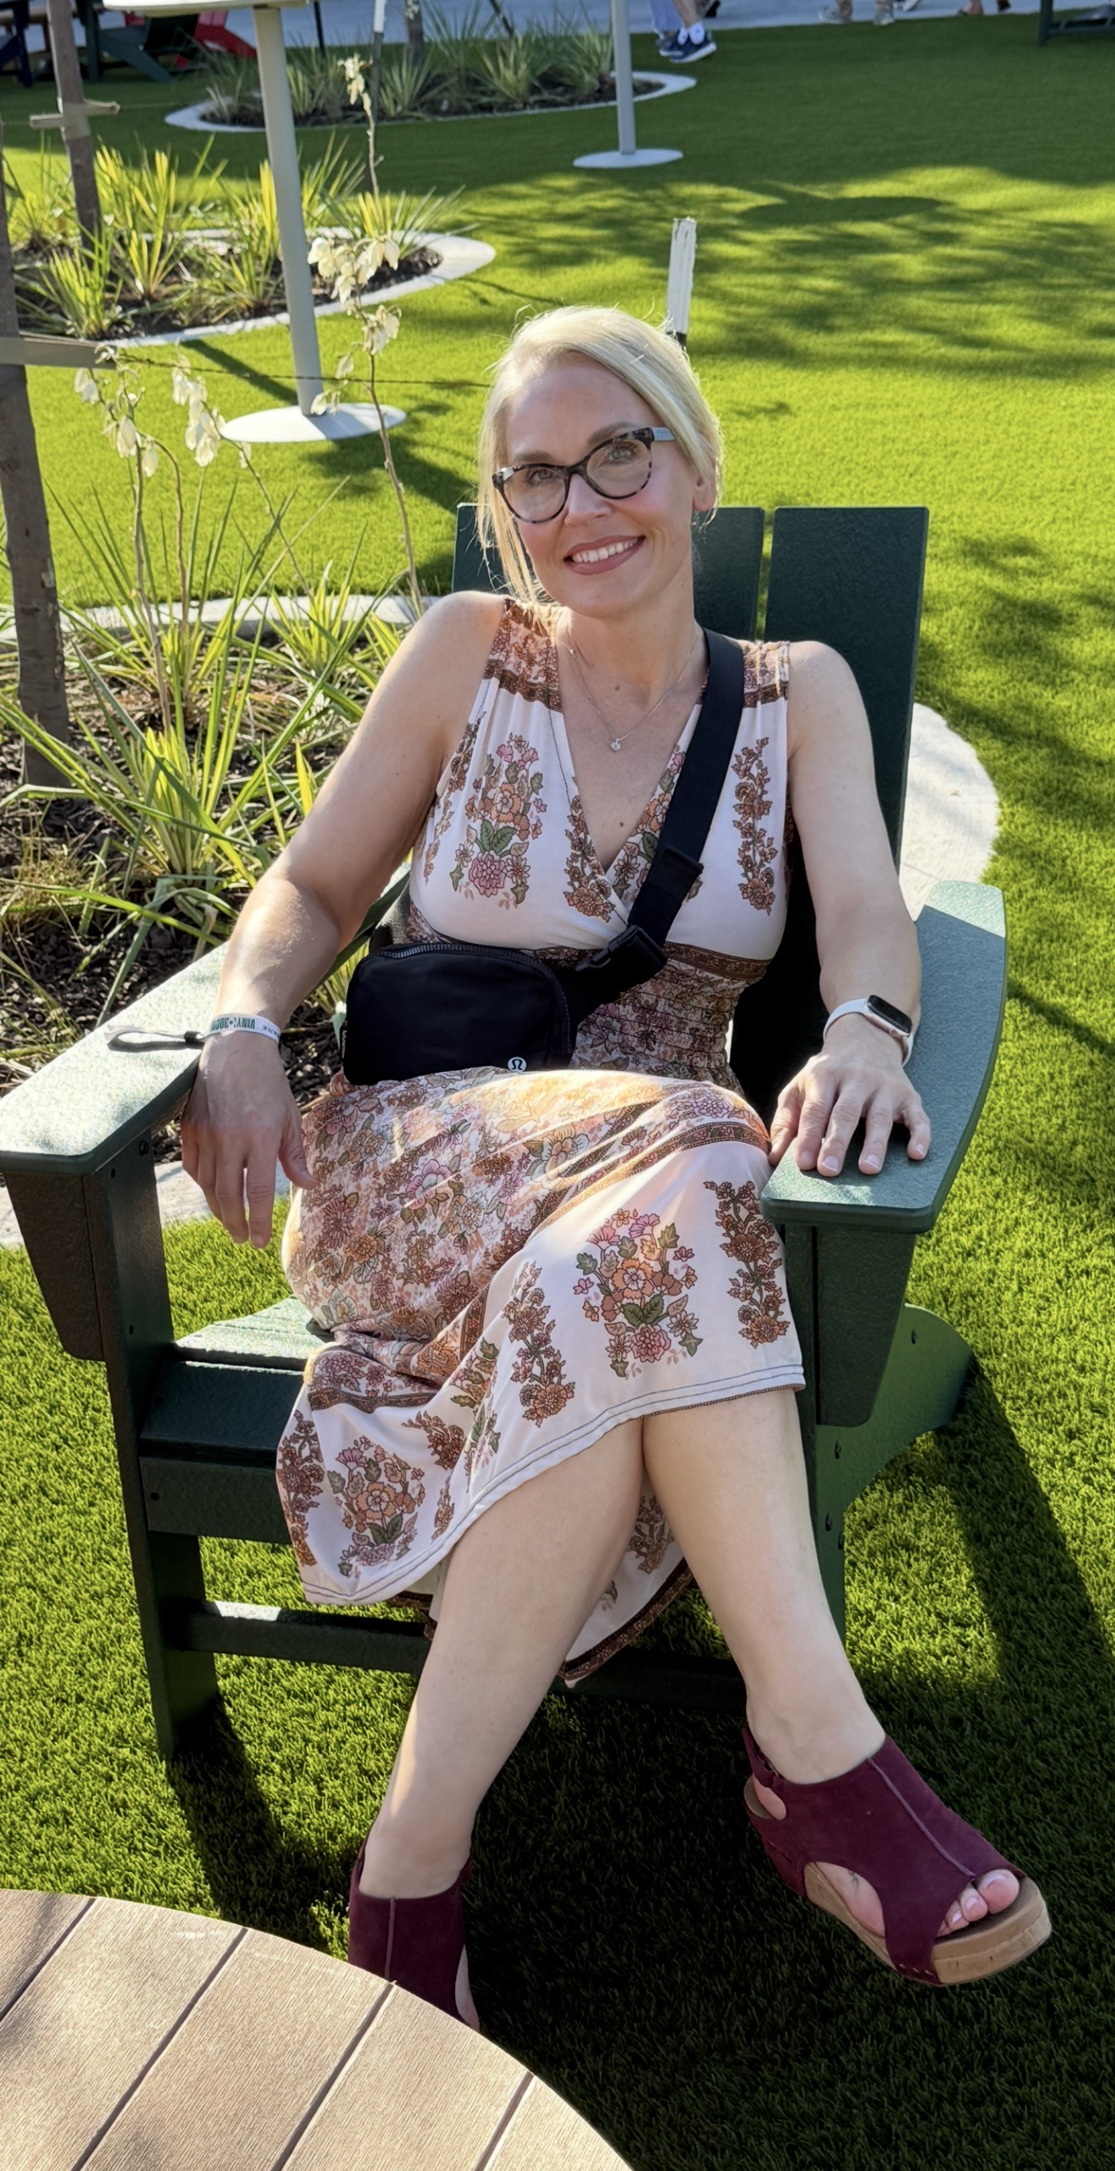
About me
Hi, I’m Skyla!
Live near Kansas City, Missouri
Mom to Christian 31, Lily 21,
and John & Tim (almost 17!)
Nurse for 24 years
Advocacy
Our story

Slide 3
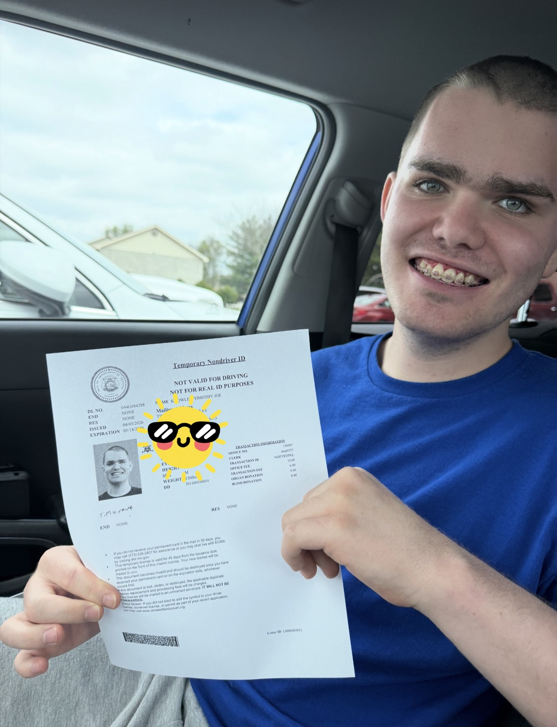
Meet tim!
Twin brother
Never met a stranger
Loves bowling, music, and dancing!
Big personality
Great sense of humor
Enjoys sports with Special Olympics, YMCA Challenger, & Exceptionals softball
Proud of his accomplishments
Has taught me more about life than he will ever know

Slide 4
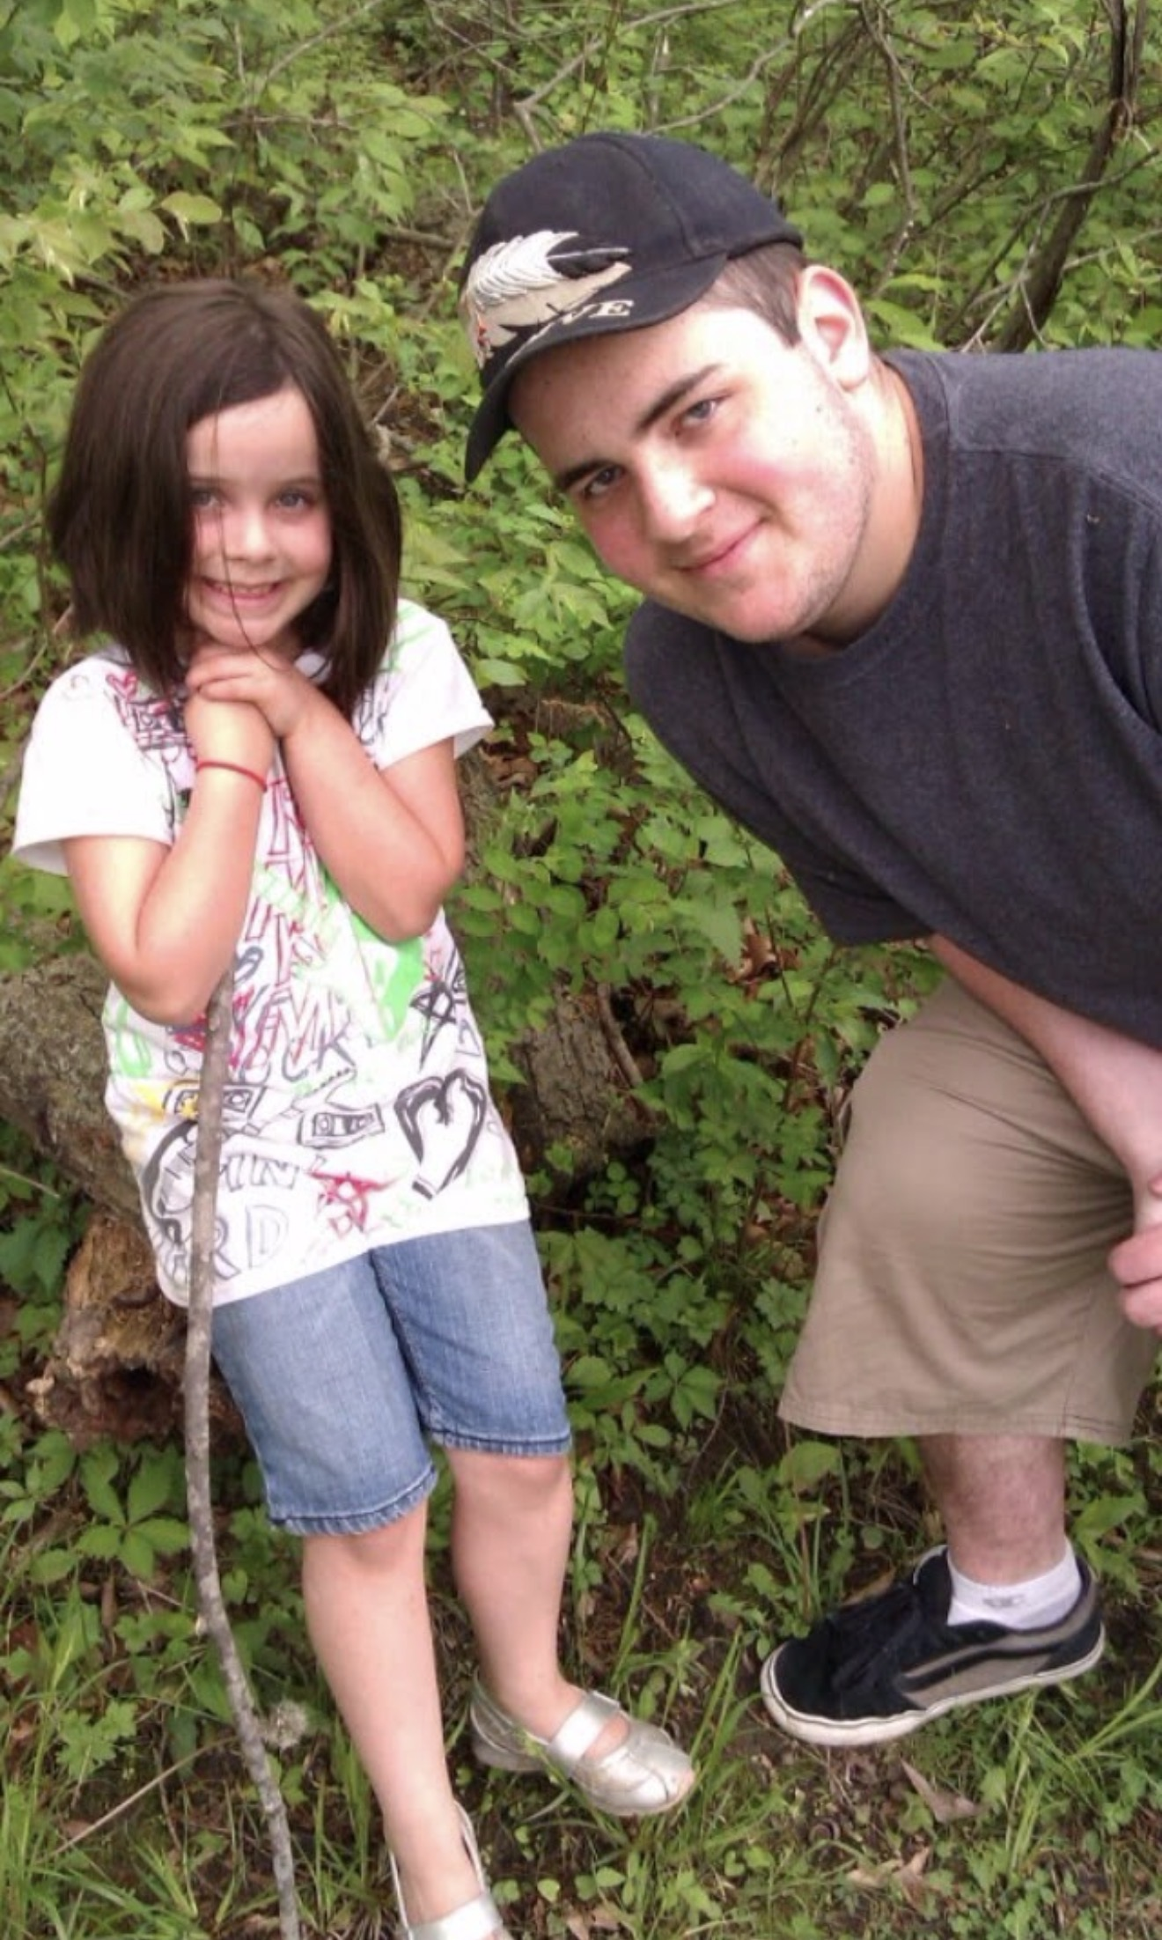
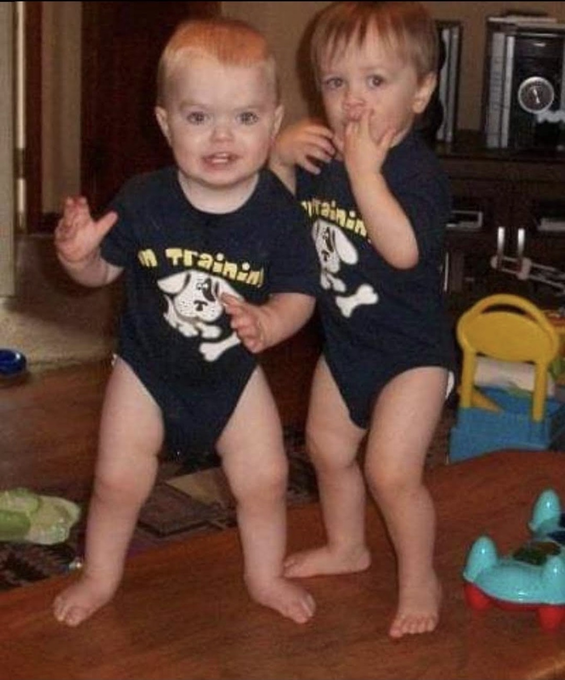

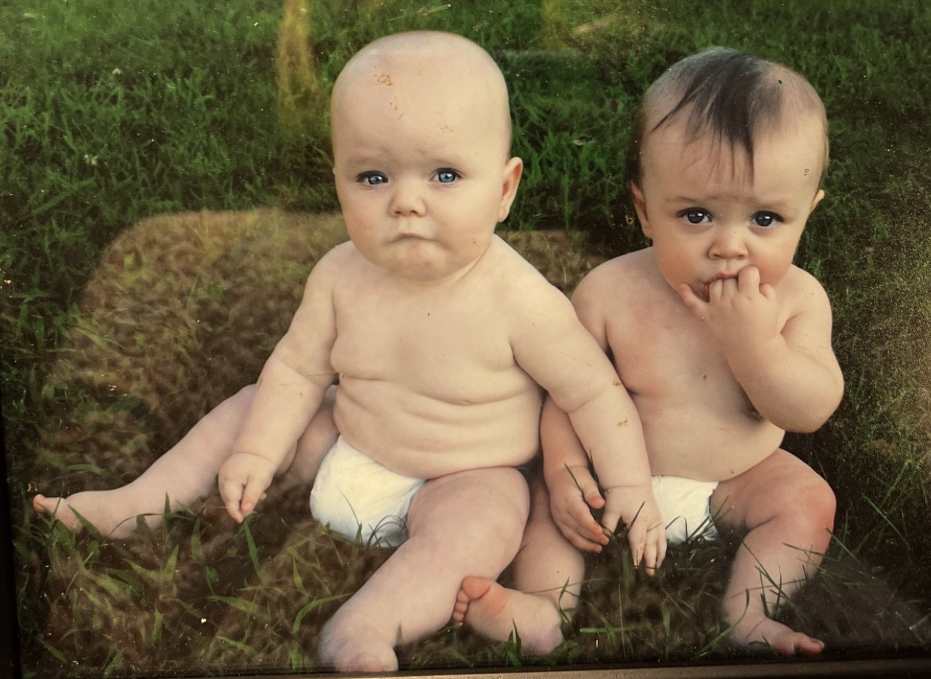
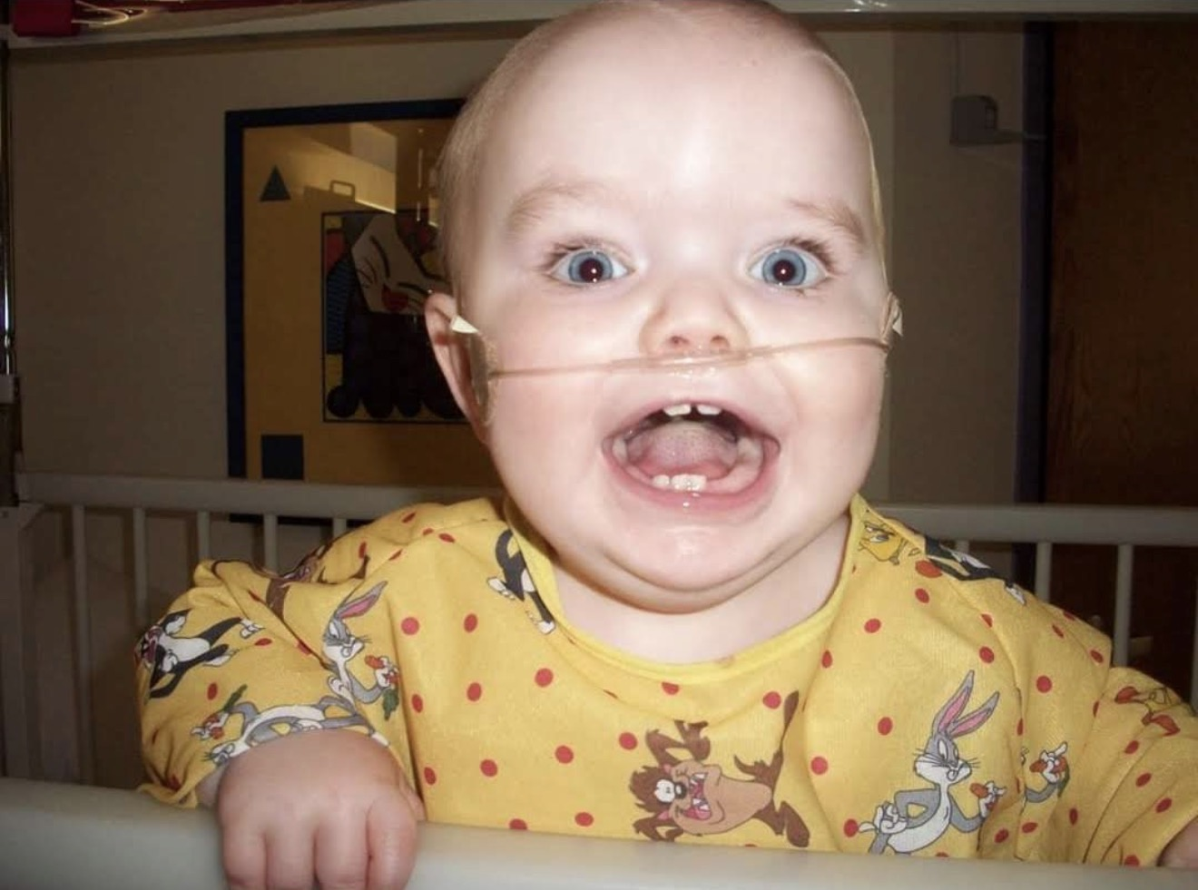
I thought I knew parenting!

Slide 5
Getting
Answers
Years of questions
Global Developmental Delay-present from infancy; no developmental “regression”
Pervasive Developmental Disorder-Not otherwise specified (PDD-NOS)
Autism diagnosis-Sept 2013, Age 3; reconfirmed in Dec 2019, Age 10
SPARK study/genetic testing results-April 2021, Age 12
-Genetic counselor
-DeSanto Shinawi Syndrome

Slide 6

Life after diagnosis
An answer, but no road map
Understanding Tim differently
Connecting with the DESSH community
Validation
Behaviors continued to escalate
Searching for the right supports
Hope
Reality

Slide 7
The journey no one sees
Constant vigilance,
lack of sleep,
and eloping
Managing behaviors
and
keeping everyone safe
Appointments,
therapies
and
medications
Always anticipating the next crisis
Losing yourself
in the chaos

Slide 8

THE RIPPLE EFFECT
Siblings-“Glass Child”
Marriage & adult relationships
Friendships & social isolation
Career, employment &
financial impact
Caregiver burnout

Slide 9

NAVIGATING
SYSTEMS
Access to resources
Eligibility does not equal availability
Wait lists, funding & service gaps
Navigating multiple agencies and systems
School systems-IEP’s, 504s & appropriate placement
Crisis-driven vs. preventative support
Mental health, emergency departments & inpatient psychiatric care
Crisis services & law enforcement
Learning to advocate and speak up

Slide 10
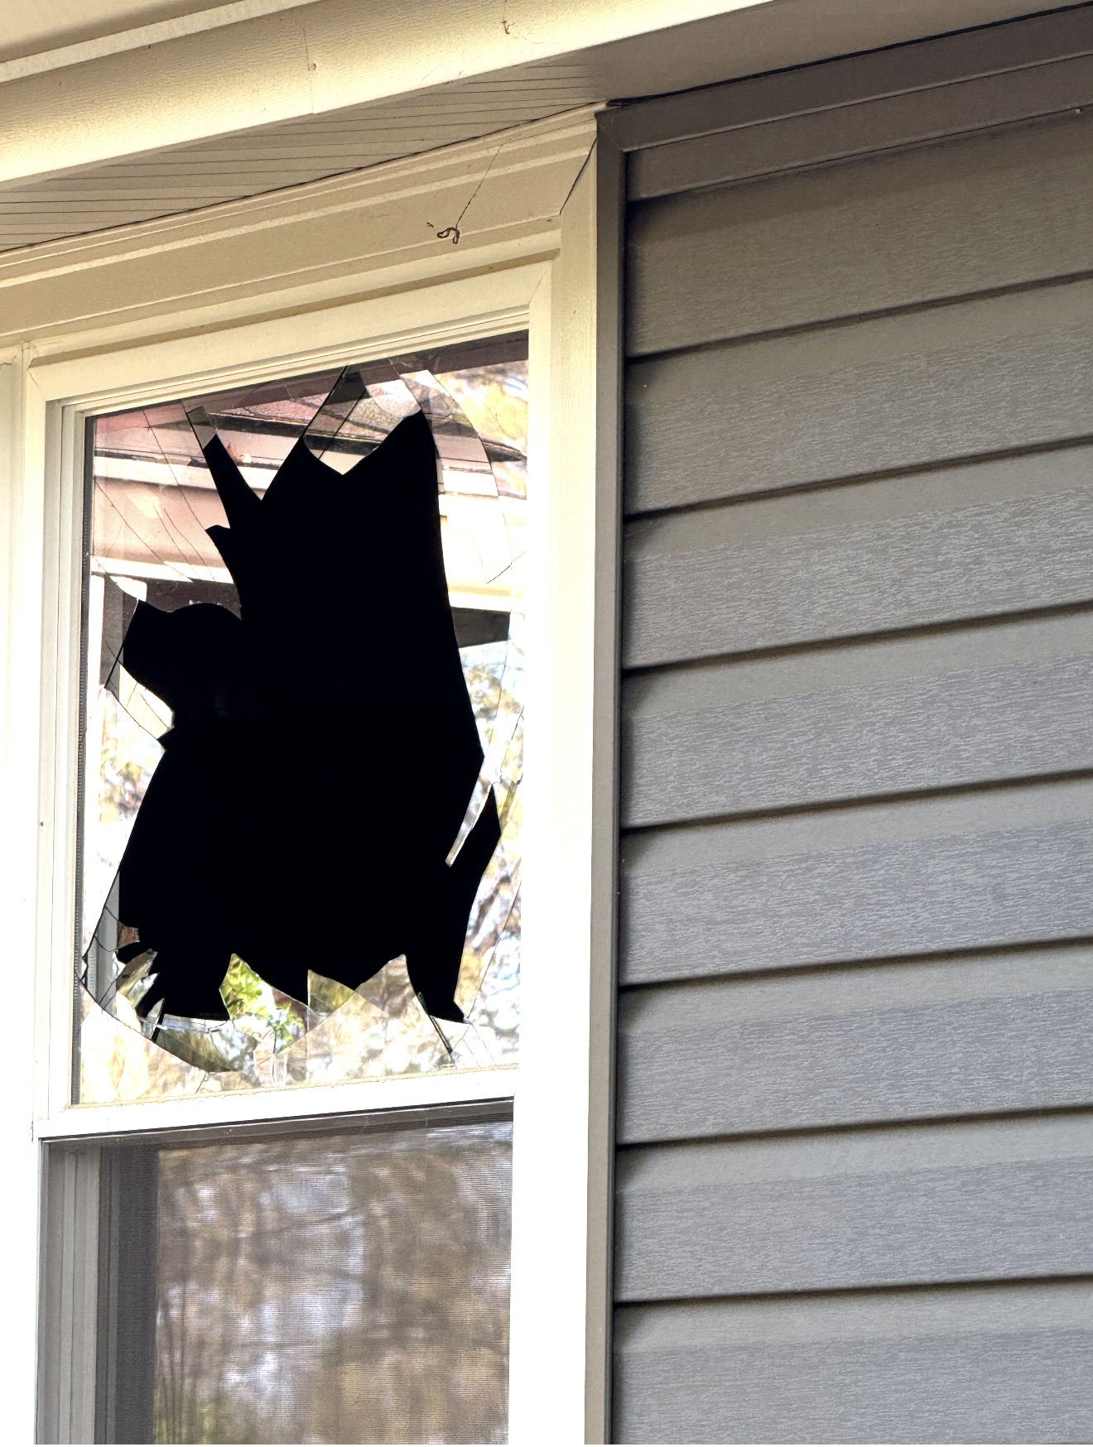
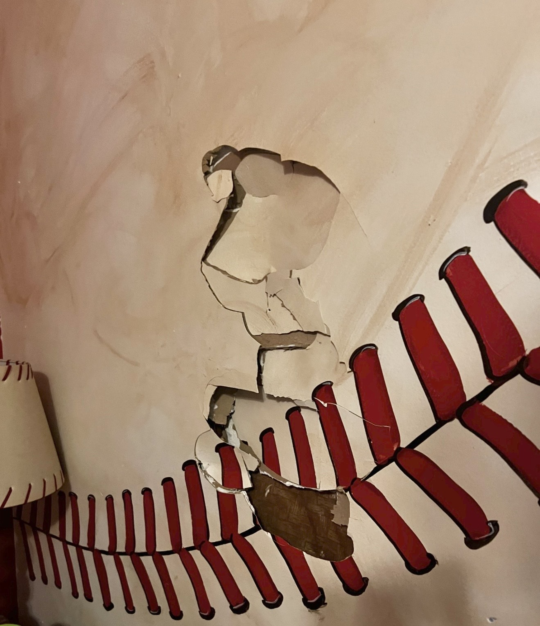
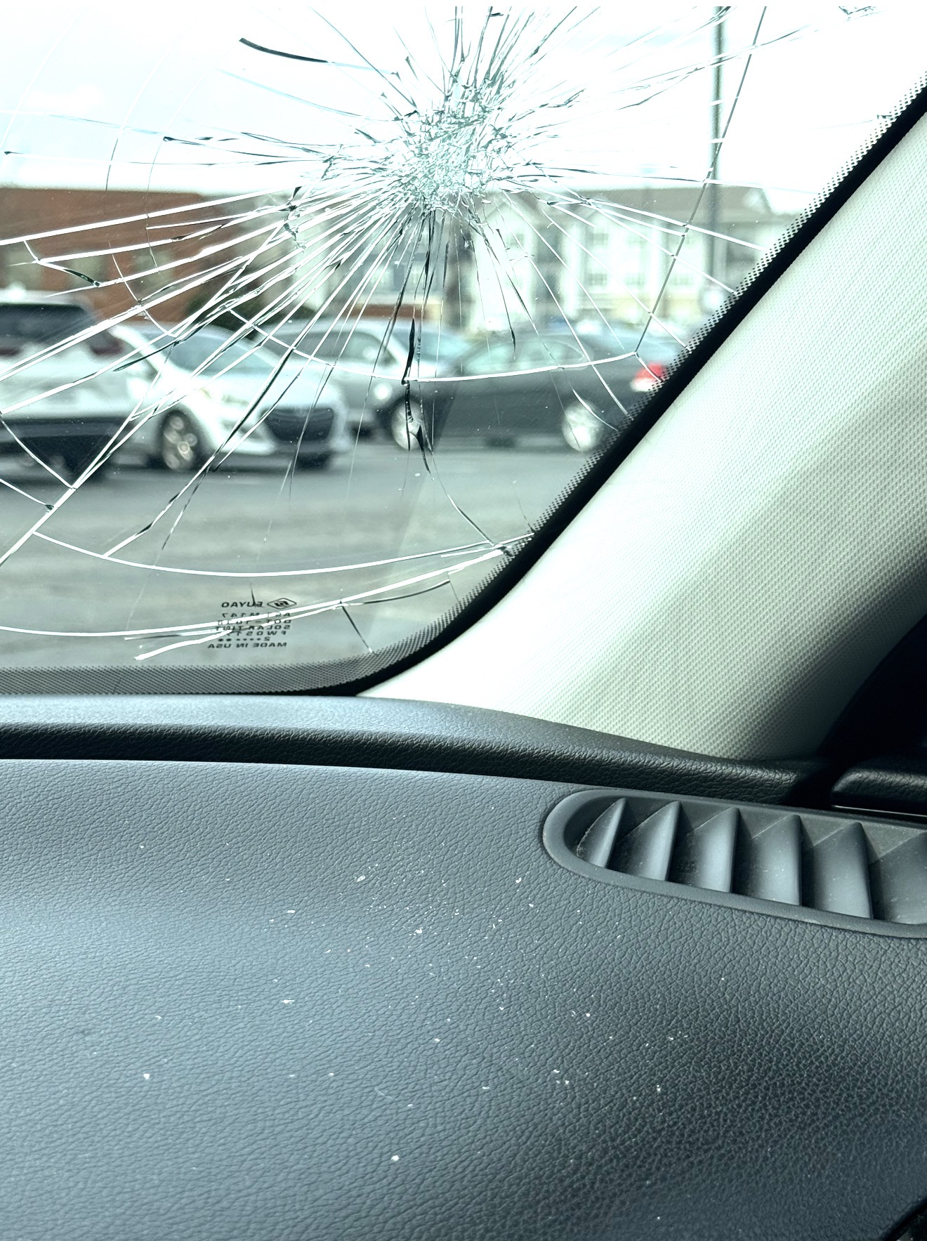
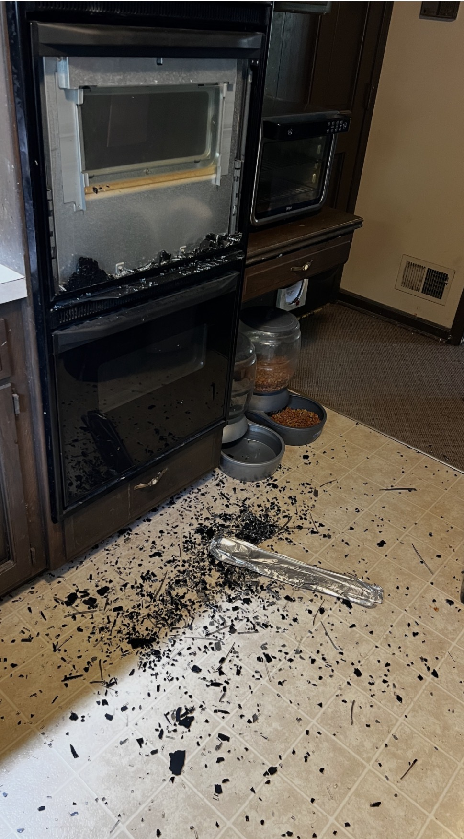
THE HARDEST DECISION

Slide 11
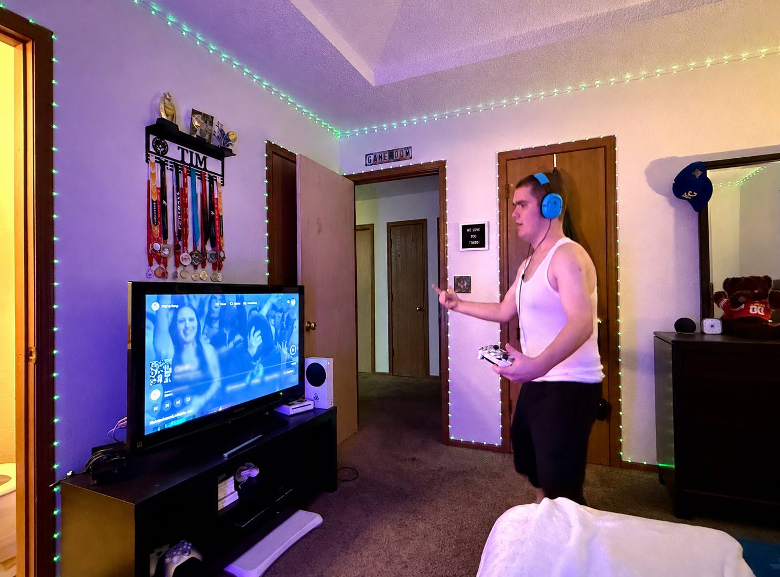
THE HARDEST DECISION

Slide 12
LESSONS
LEARNED
Trust your instincts
There is no shame in changing the plan
Safety and love can coexist
Grief and gratitude can coexist
Find the people who believe in you
Comparison is the thief of joy
Even the hardest seasons can
leave us with
something worth carrying forward

Slide 13
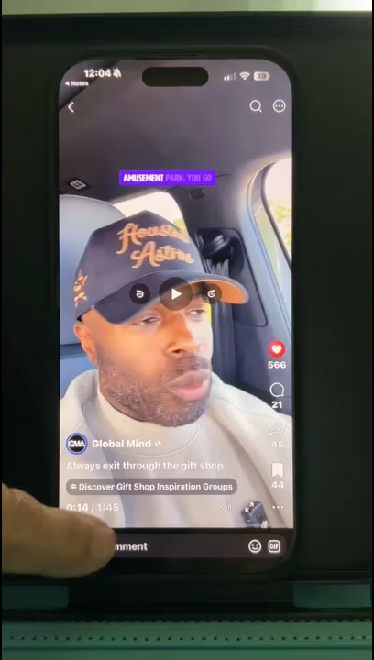
“Always exit through
the
gift shop”
ALWAYS EXIT
THROUGH
THE GIFT SHOP

Slide 14

THE GIFTS YOU CARRY
Perspective
Compassion
Advocacy
Community
Resiliency
Grace
Gratitude
Hope

Slide 15
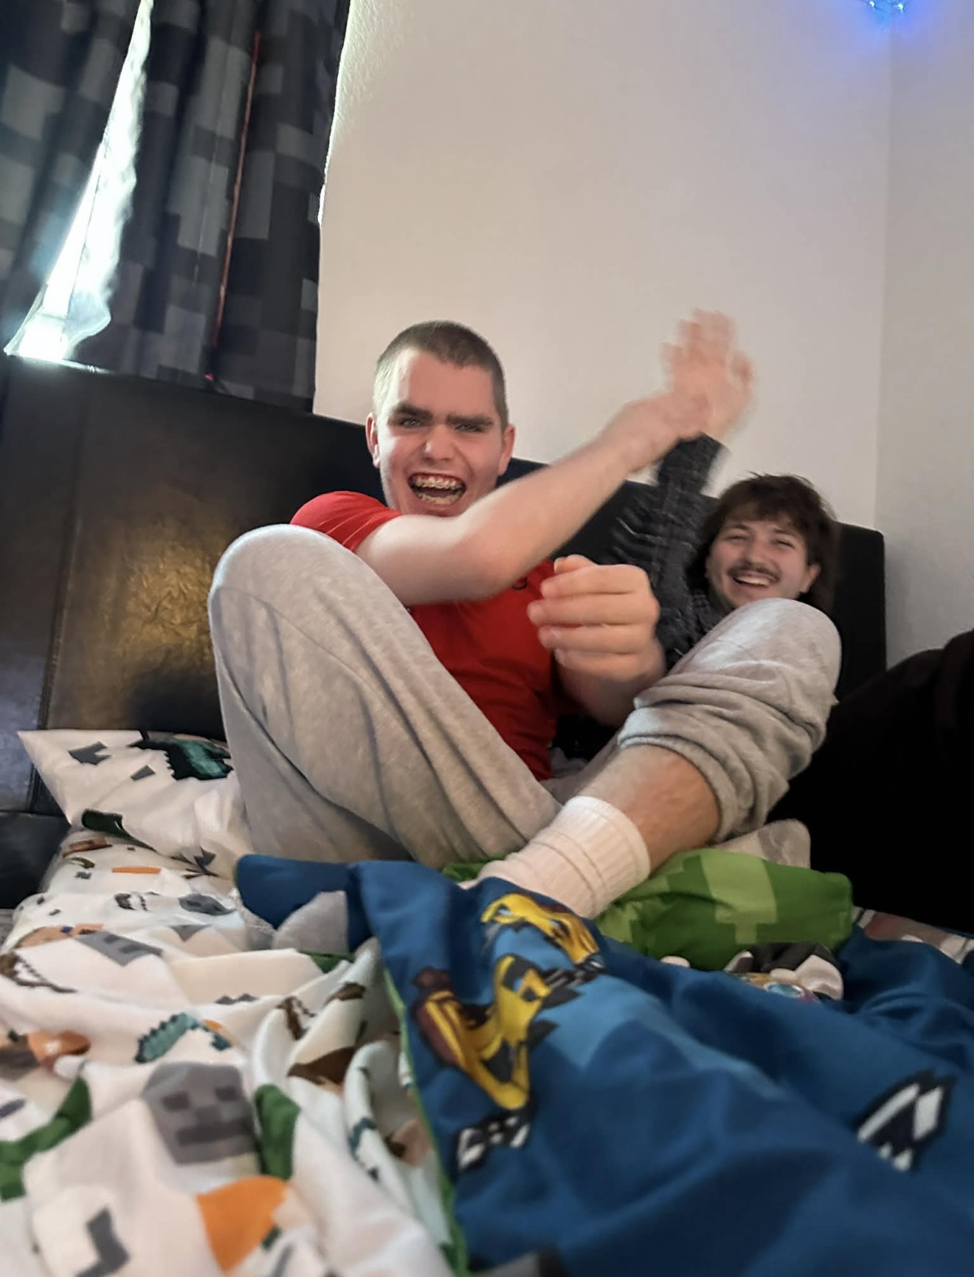
“Everything can be taken
from a man but one thing:
The last of the
human freedoms-
to choose one’s attitude
in any given set
of circumstances”
~Viktor Frankl

Slide 16
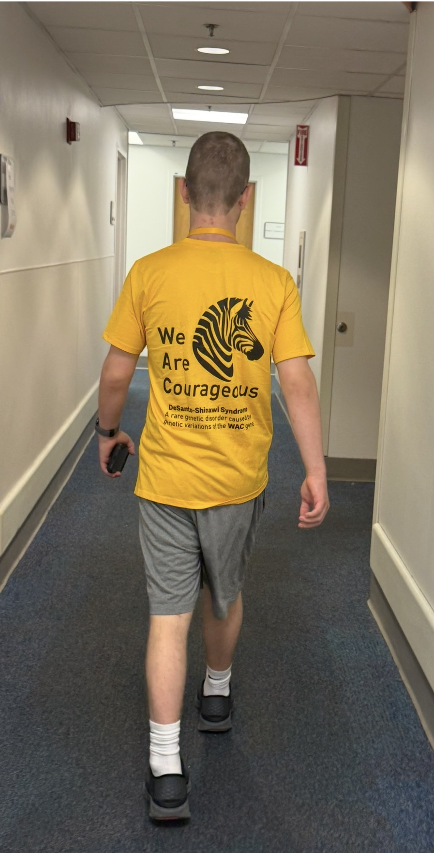
REFLECTION
Special thanks to Dr. Shinawi and his medical team for their dedication to the DESSH community; to the families who have traveled from around the world and who continue to share, support and learn from one another; and for the opportunity to share a small part of Tim’s story and our family’s journey.
Questions, comments……

